Slide 1
Eden: Developer-friendly User-space Far Memory
Anil Yelam, Stewart Grant, Saarth Deshpande, Nadav Amit,
Radhika Niranjan Mysore, Amy Ousterhout, Marcos K. Aguilera and Alex C. Snoeren

Slide 2
In a nutshell
Eden replaces most page faults with page fault hints to an user-space pager
Application
Application
Far Memory
Pager
OS
Far Memory
OS
Pager
Userfaultfd
Fastswap, etc.
Page faults + OS swap system
Eden
Page fault hints + User-space pager enabled by Userfaultfd

Slide 3
Kernel-based approaches
e.g., Fastswap
More recent examples: Canvas, Hermit (NSDI’23)
OS swapping to remote memory
Fully transparent
But suffer from
Performance overheads (Page fault costs, hard to hide latencies, etc.)
Semantic-gap

Slide 4
Runtime-based approaches
e.g., AIFM
Custom object-based interface + user-space runtime
Access far memory objects through C++ smart pointers
Minimizing changes through far-memory versions for common data structures
Removes page fault costs & I/O amplification
Better latency hiding using user-level threads
Application-informed memory management
But prohibitively many changes which is non-incremental and hard to use
Example: DataFrame

Slide 5
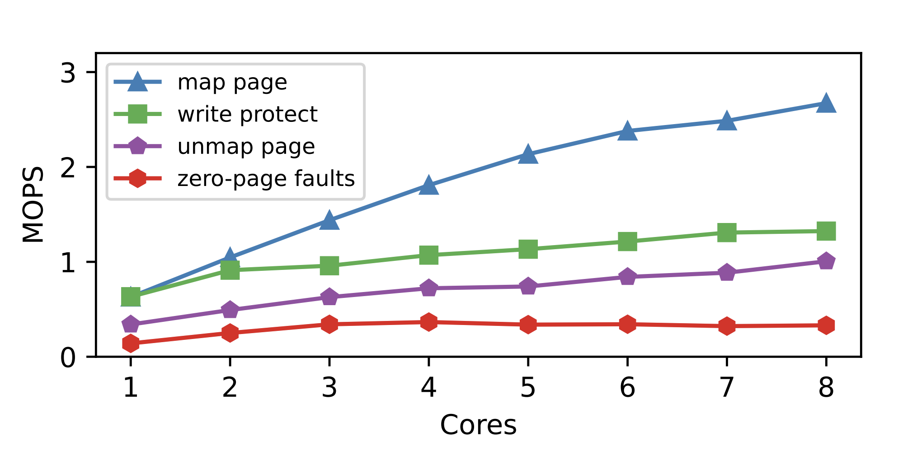
Hybrid design aka Kona
Page management in Userspace with Userfaultfd
Even higher page fault cost
Poor scalability (with single fd)
Dedicated cores – non-scalable design
Userfaultfd calls

Slide 6
Eden Insight
Preempt page faults with hints to User-space pager
Pass context around the access with hints e.g., read-ahead

Slide 7
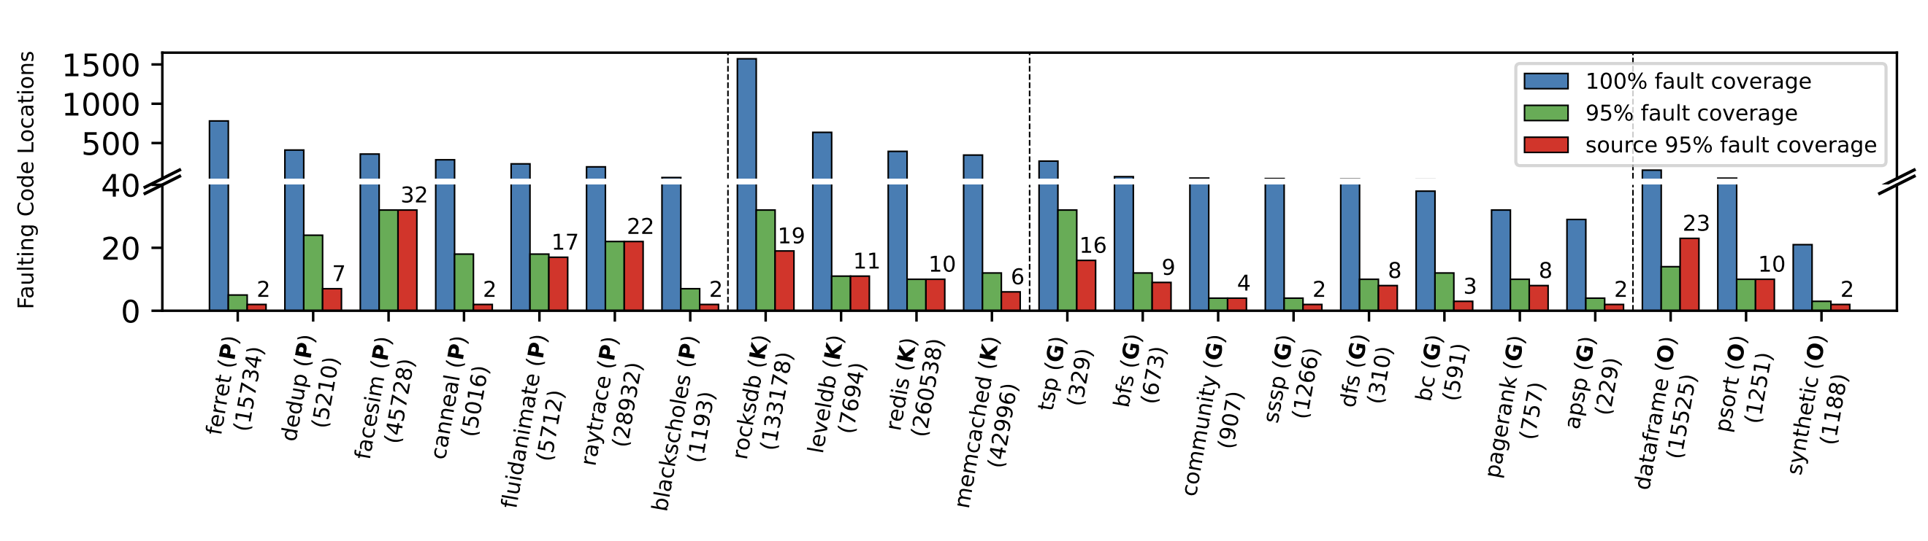
Only a handful of locations to hint!

Slide 8
Eden Design Goals
Goal | Mechanism
Low developer effort | Only a handful of page fault hints
Flexible policies | Application-specific Can pass application context with hints
High paging throughput | Avoid userfaultfd page fault cost with hints Batched reclaim with vectorized UFFD calls Scalability through per-core fault handling runtime

Slide 9
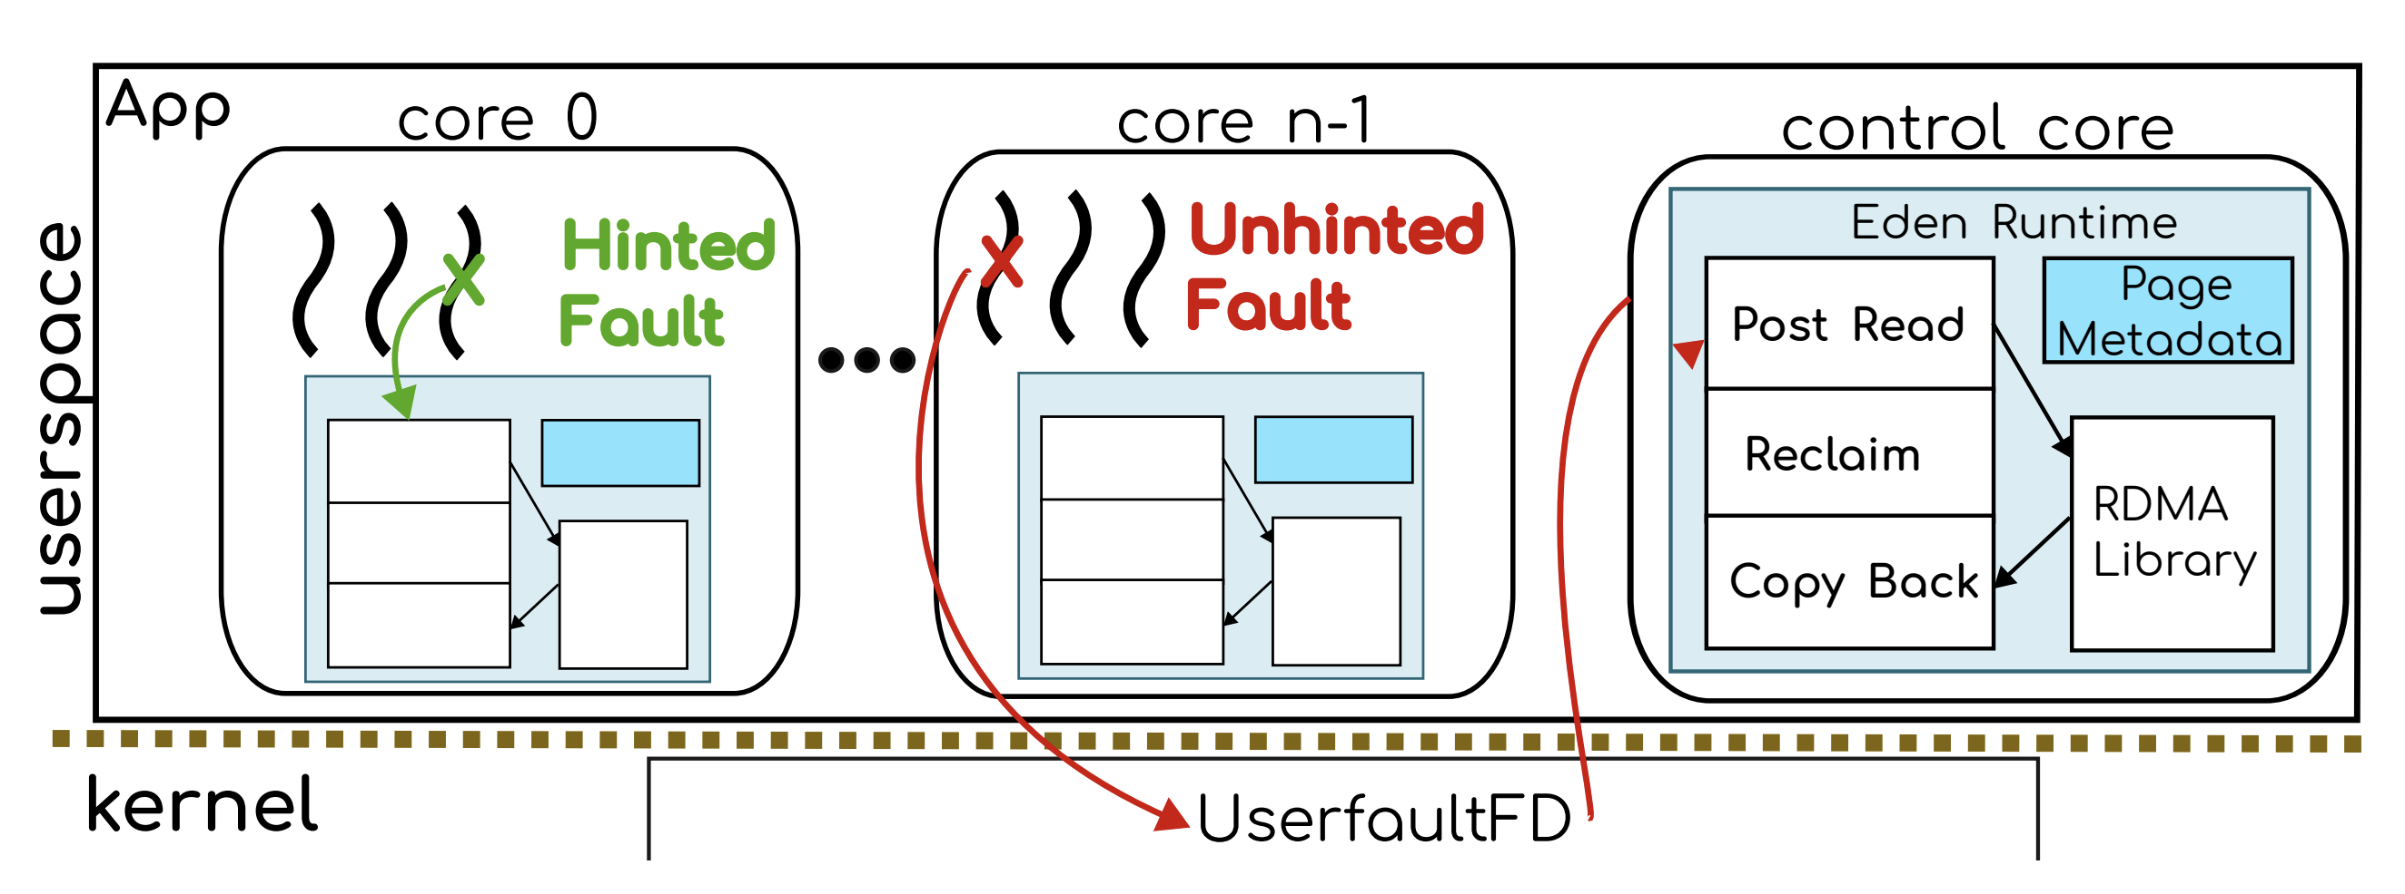
Design
1. Per-core fault handling and RDMA queues for hinted faults
2. Un-hinted faults are handled on a dedicated control core

Slide 10
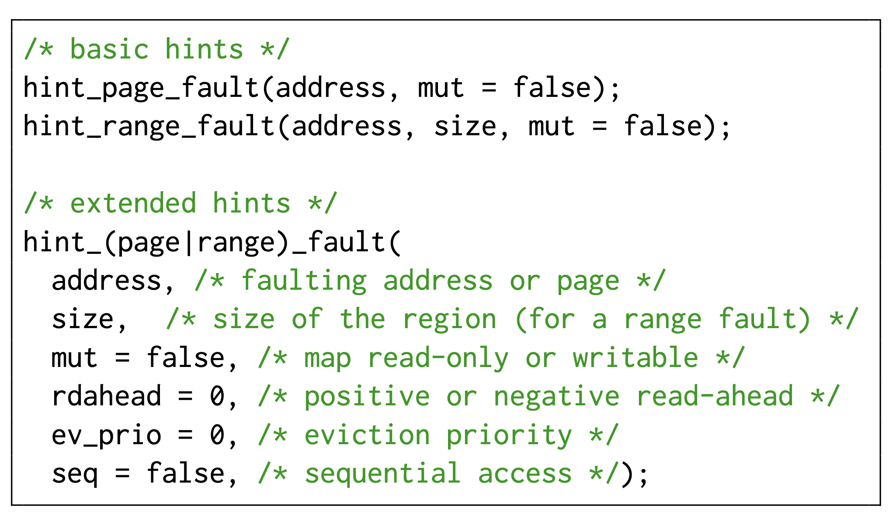
Hint API

Slide 11
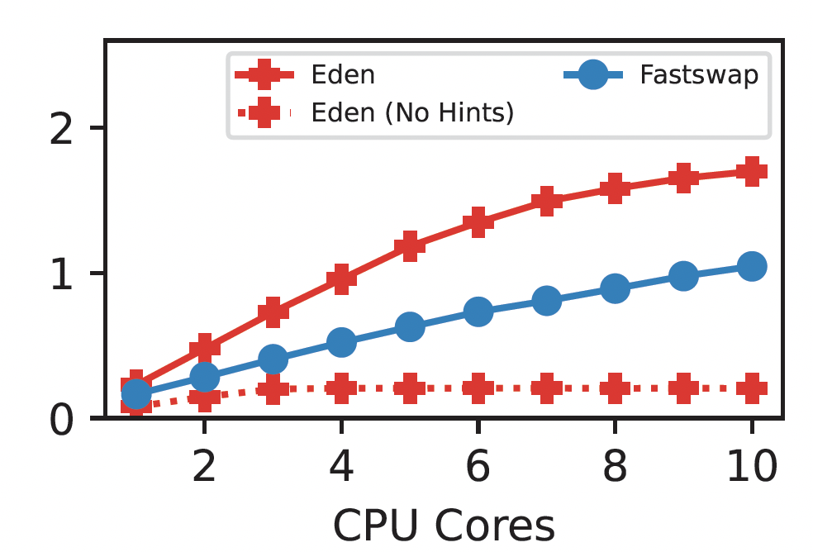
Basic hints
Mandatory for good performance!
Help with User-space paging throughput
Allow hiding latencies
MOPS

Slide 12
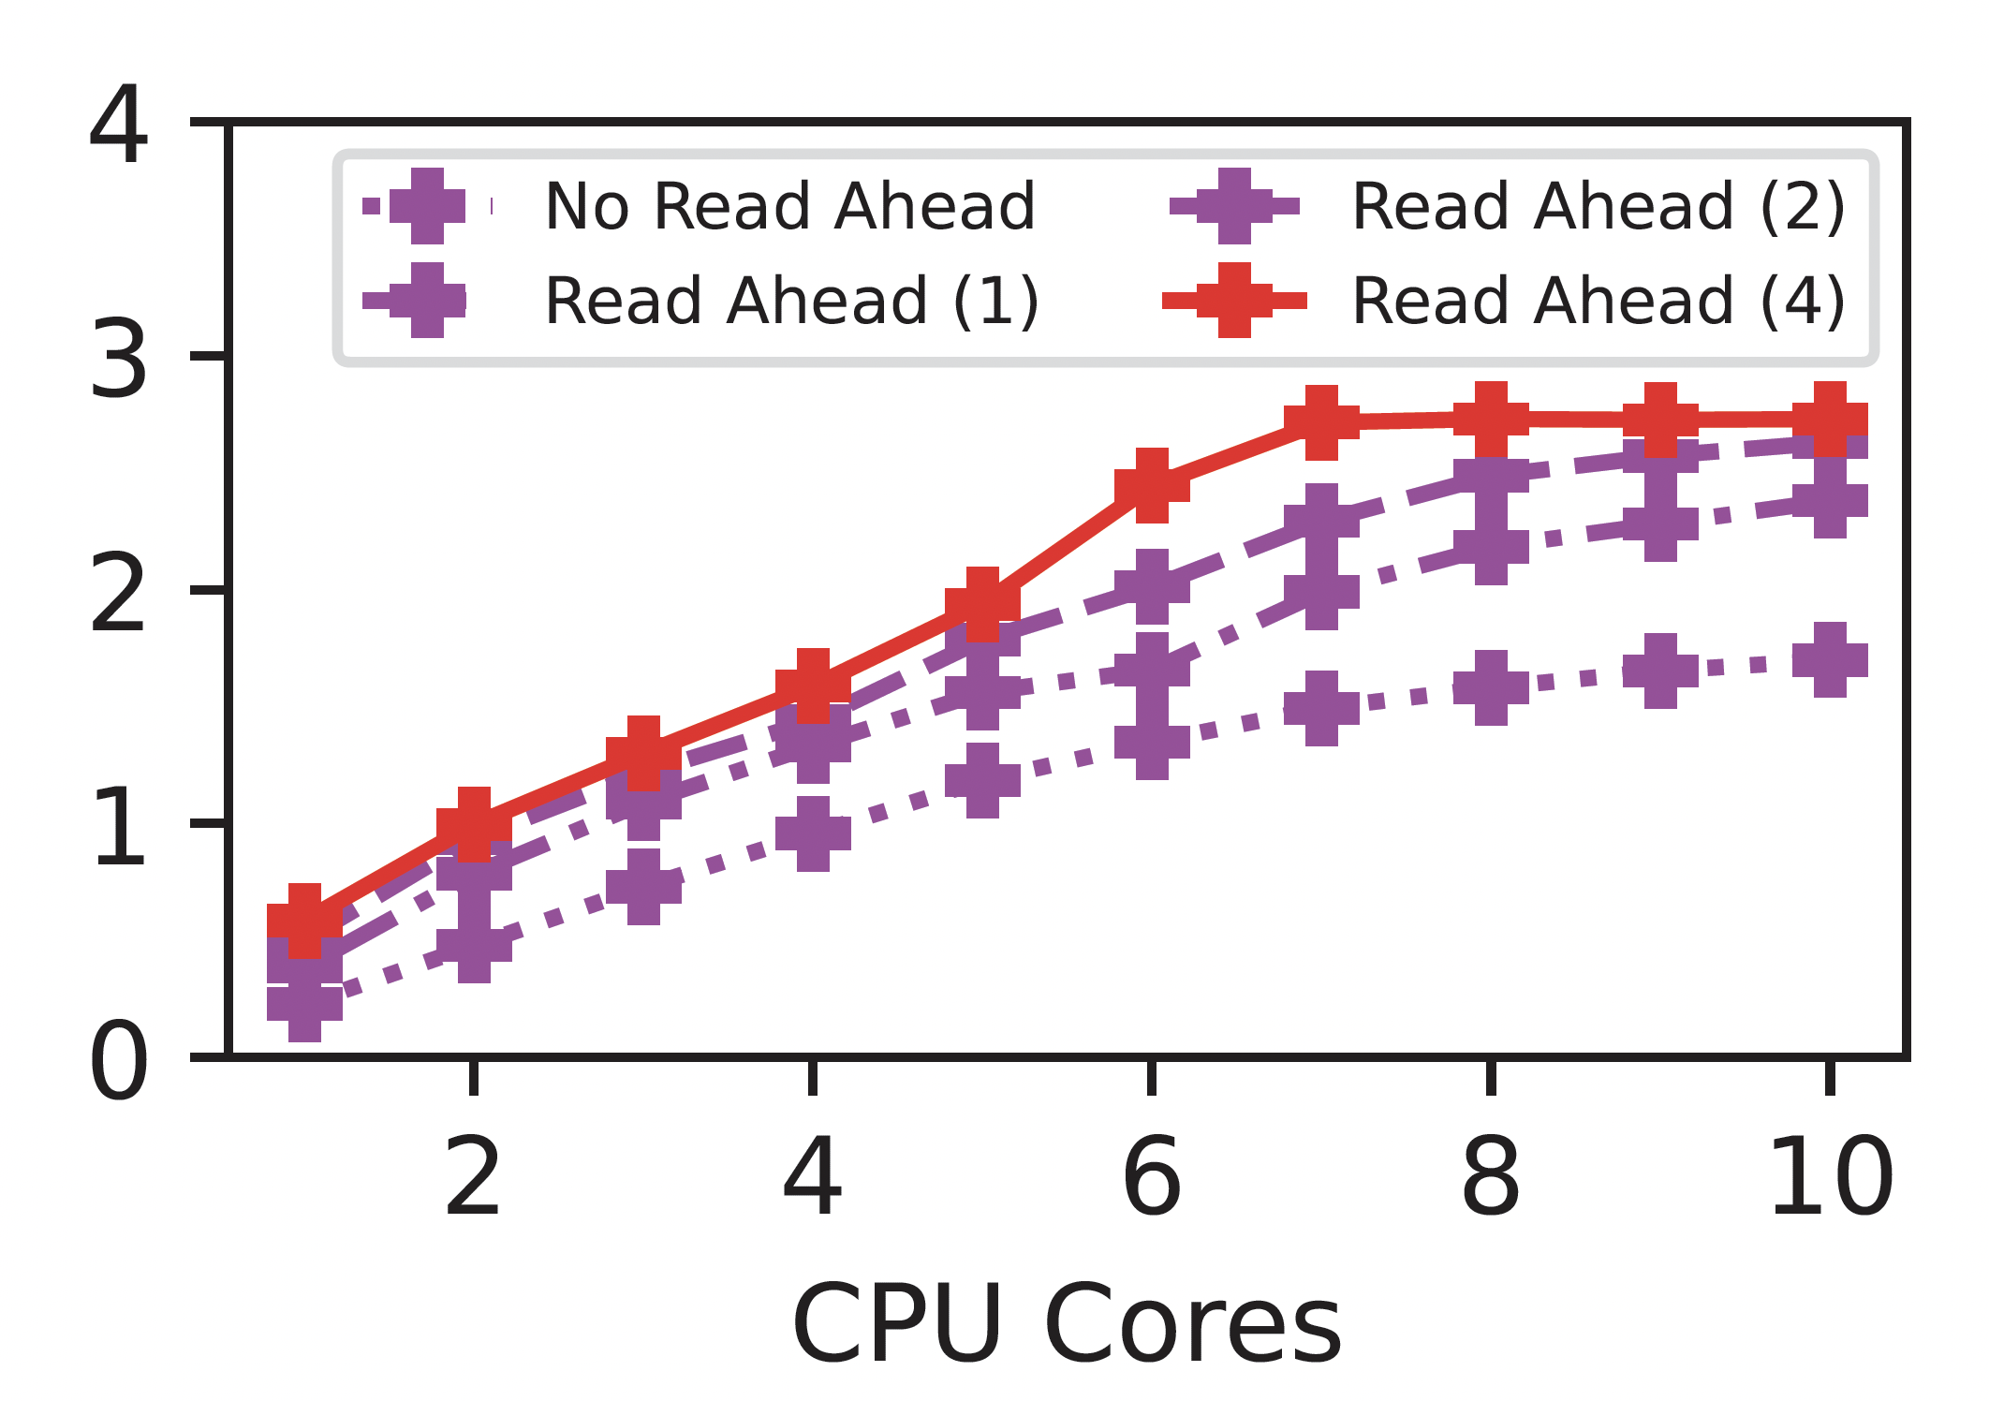
Extended hints
Read-ahead
Reclaim priority

Slide 13
Hinted vs. Un-hinted Paths
Worker core
Control core
hint_page_fault()
Check for page existence
Uffd_poll()
Lock the page
Post RDMA read
Reclaim pages if needed
Schedule another thread
Check for RDMA completions
Uffd_copy()

Slide 14
Fault handling
Concurrent faults
Added to local wait queues
Monitored on thread yields
Fault stealing
Cores can steal waiting faults or RDMA completions
Mainly for load balancing
Control core steals to avoid deadlocks

Slide 15
Reclaim
Mechanism
UFFDIO_WRITEPROTECT and madvise(MADV_DONTNEED)
Added vectored variants for batching
Indirect reclaim on control core
Direct reclaim on every core when needed
Policies
Hints allow various ways to record access
Currently supports FIFO (default), SC, LRU and Priority policies

Slide 16
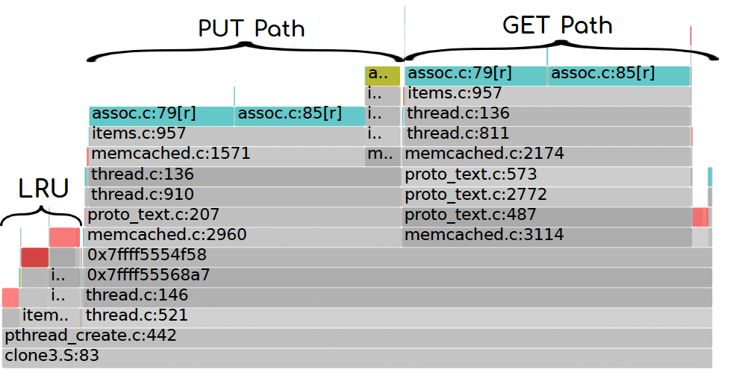
Other noteworthy features
Memory interposition with a shim library and jemalloc
Fault tracing both in Eden and as a stand-alone tool, fltrace
Outputs Flame-graphs for un-hinted faults

Slide 17
Evaluation
Hinting effort – much better than AIFM
Performance & flexibility – on par with AIFM

Slide 18
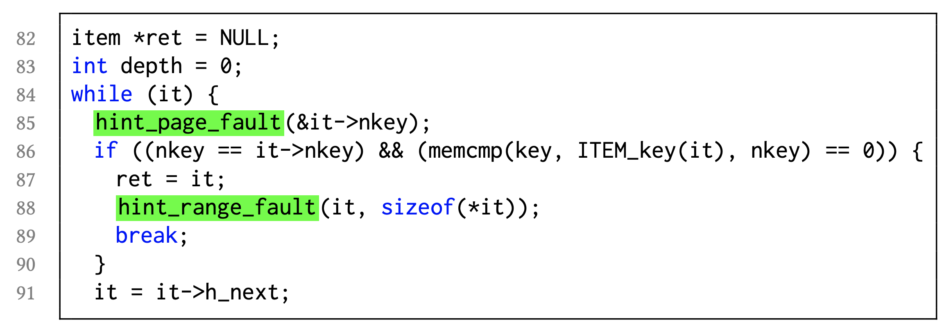
Case study: Memcached
(traced at local memory = 10% of the max resident set size)
Trace faults with Fltrace
Two basic hints: assoc:70 and assoc:85
Turned-off LRU
An extra range hint assoc:88 to cover tailenders

Slide 19
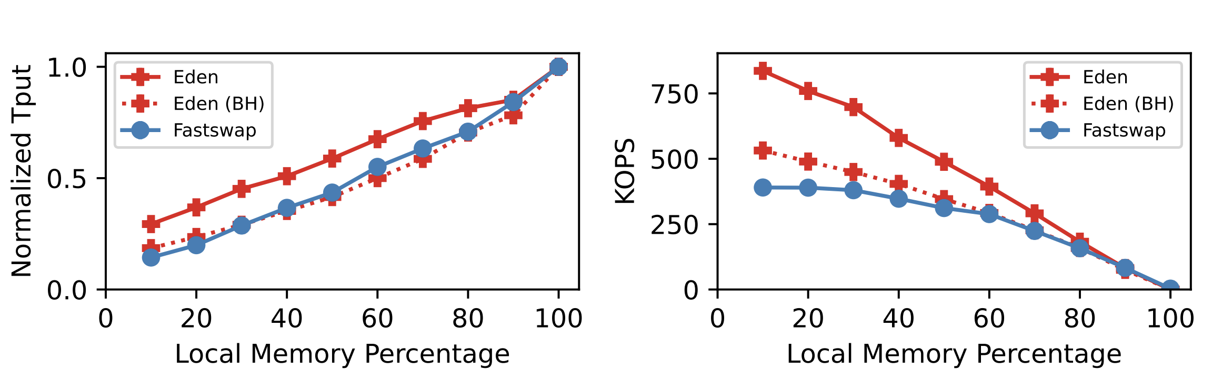
Memcached Performance
Performance gain from basic hints (mostly from network latency hiding)

Slide 20
Hinting DataFrame library
Pandas-like C++ library
Benchmark runs 9 analytics queries
AIFM far-memory porting:
Updates to Dataframe data structure
Changing all references in the code
Adding appropriate dereference scopes
Result: 1100 LOC changes or 7.7% of the code base

Slide 21
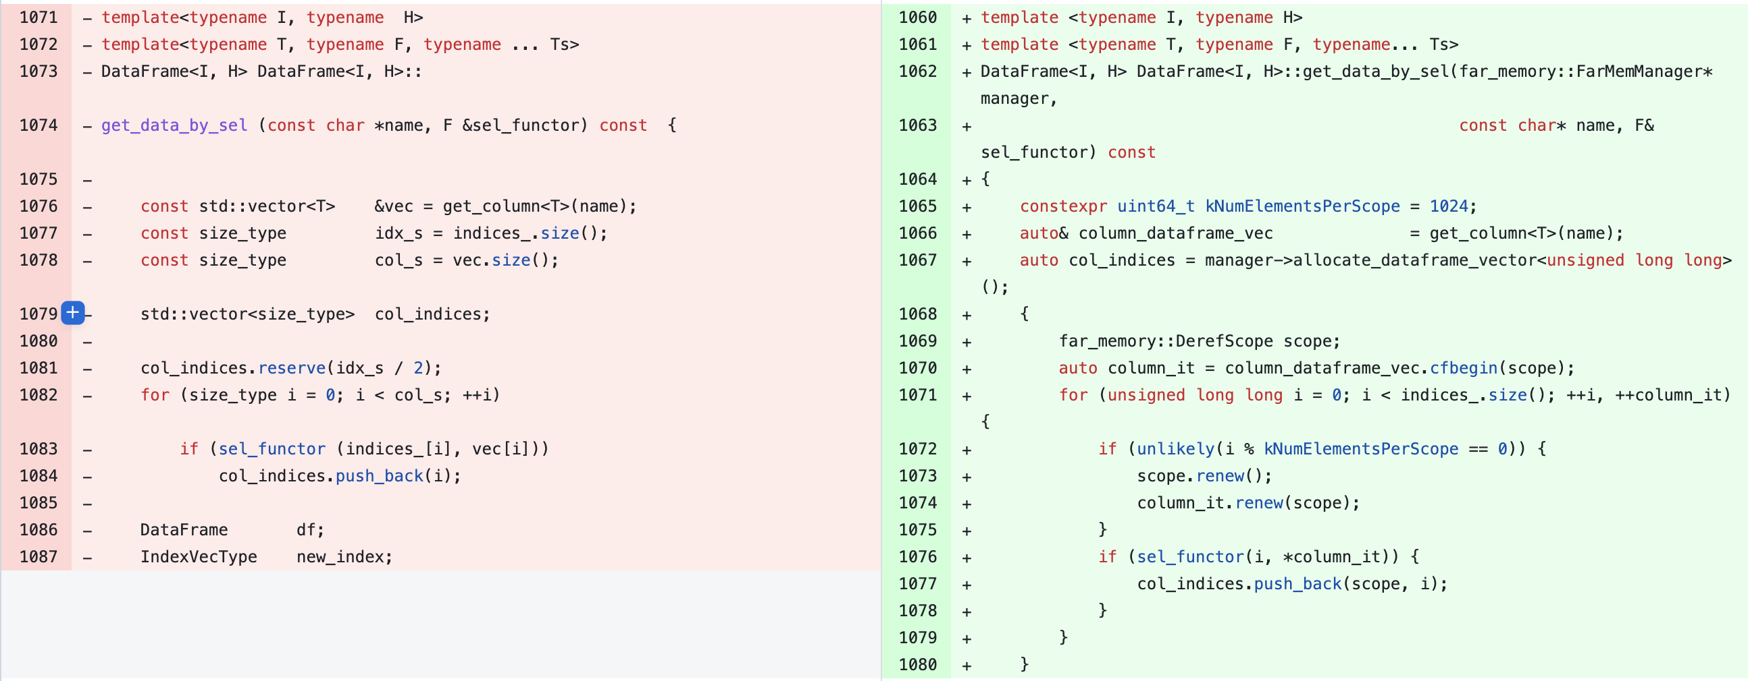
AIFM changes example

Slide 22
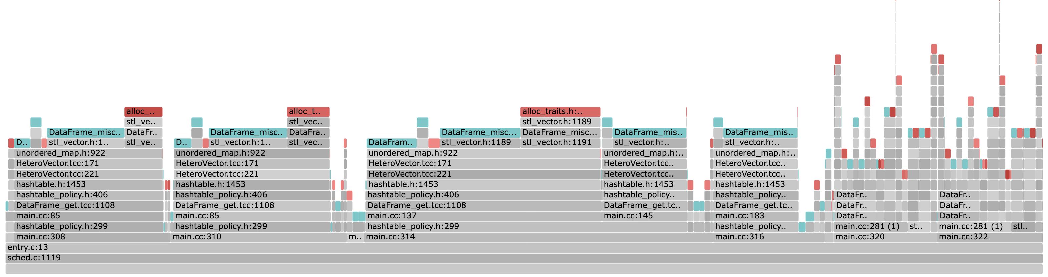
DataFrame Fault Graph
Includes first-time faults too, non-localized
(at 10% local memory – for all the analysis here and after)

Slide 23
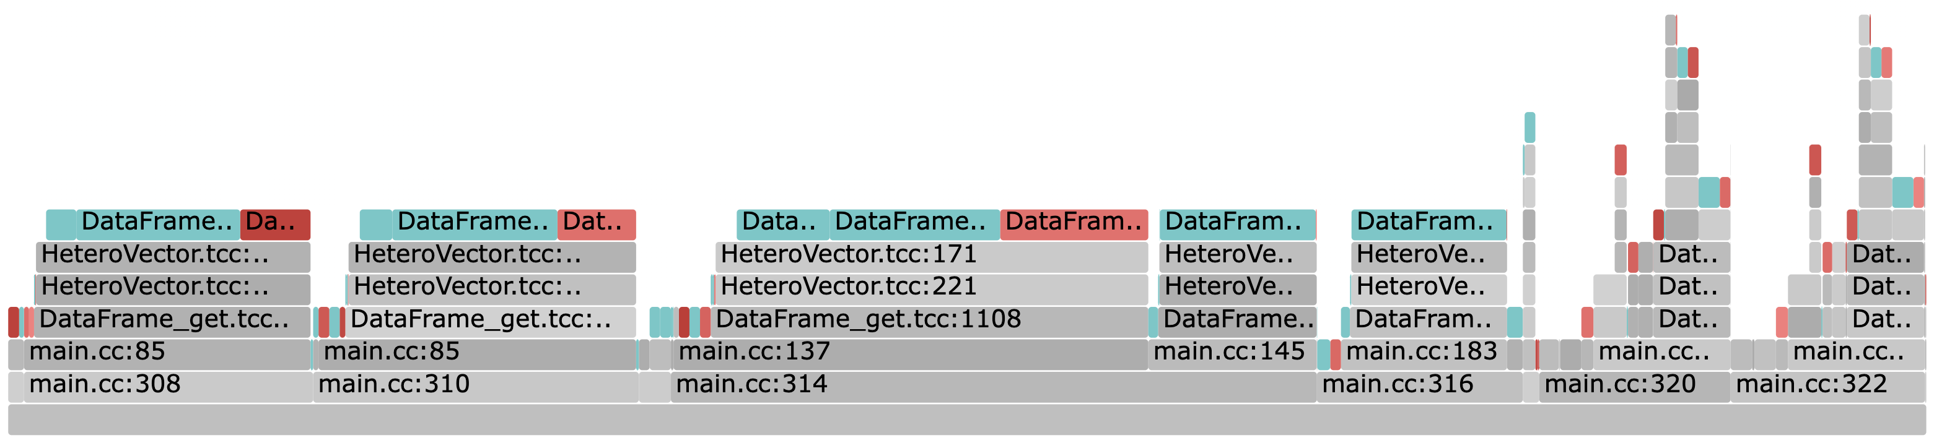
DataFrame Fault Graph
Localized to the benchmark and the library

Slide 24
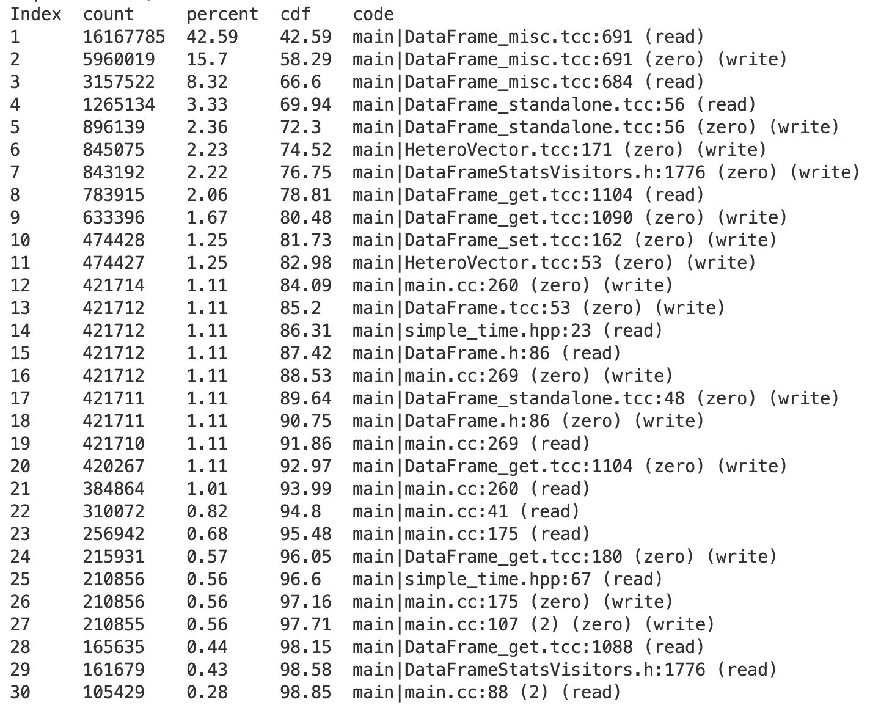
Hinting top locations
23 locations for 95% (even lesser lines of code)
Top 3 locations cover ~66%
Took me a few hours

Slide 25
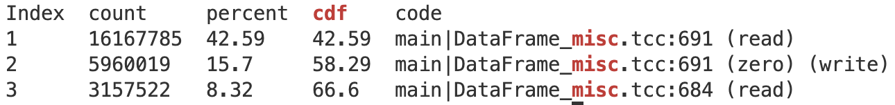
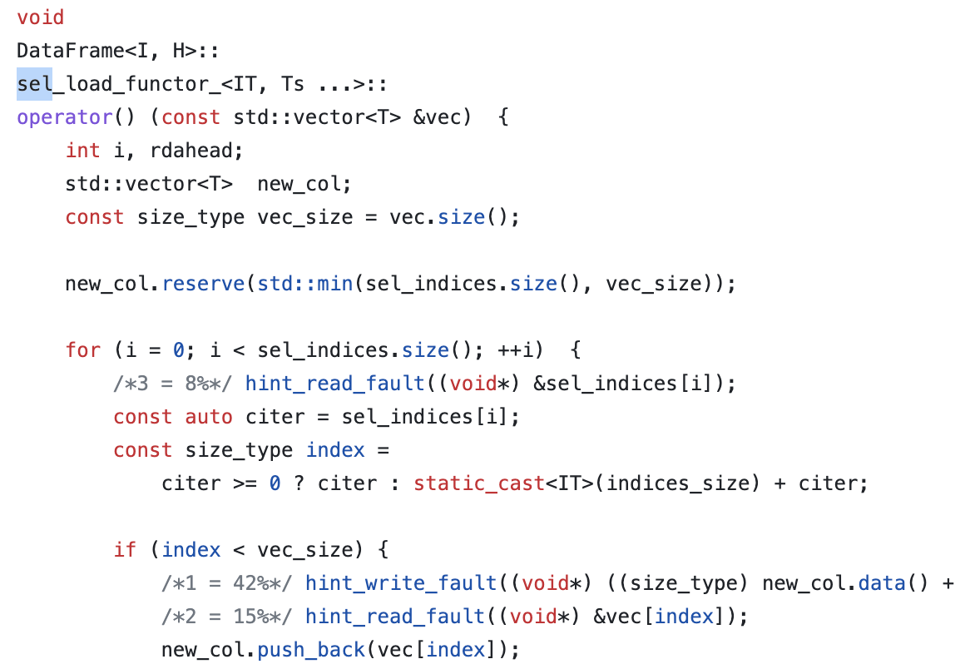
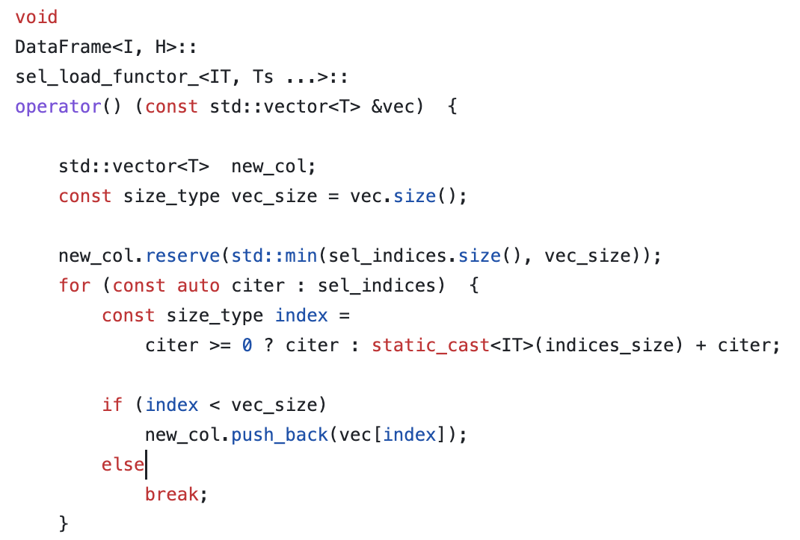
Basic hinting example
Eden hints
Original

Slide 26
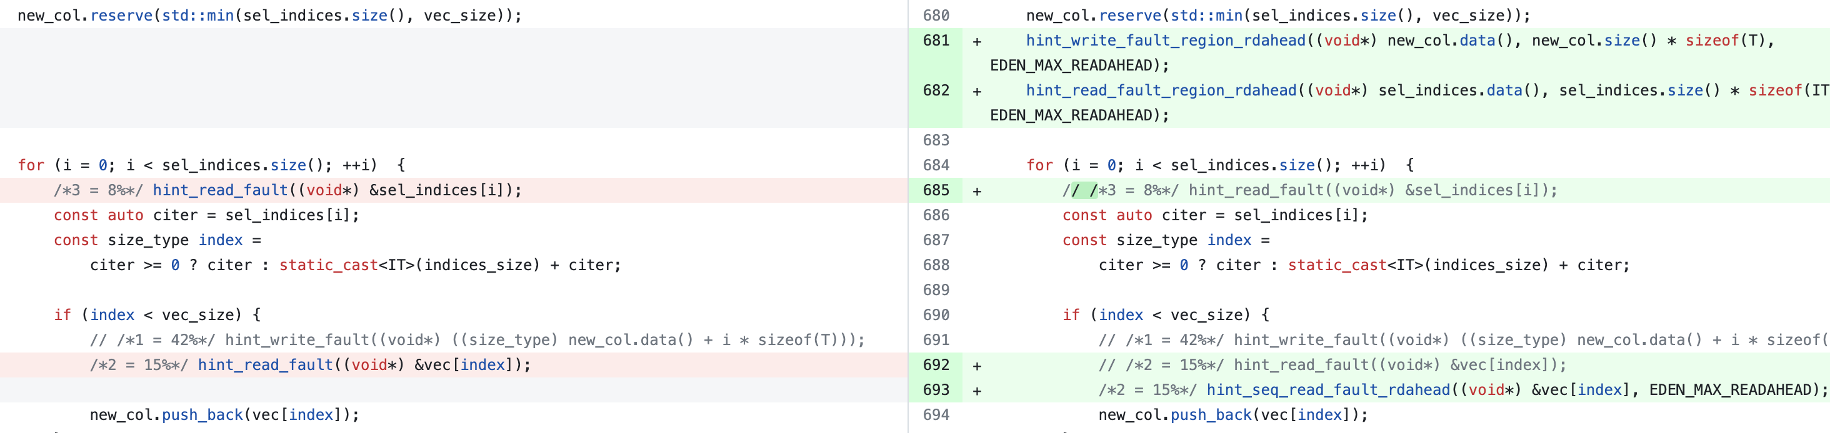
Basic → “Smart” (extended) hints
Set sequential flag to reduce hinting overhead
Set read-ahead – huge impact from batching

Slide 27
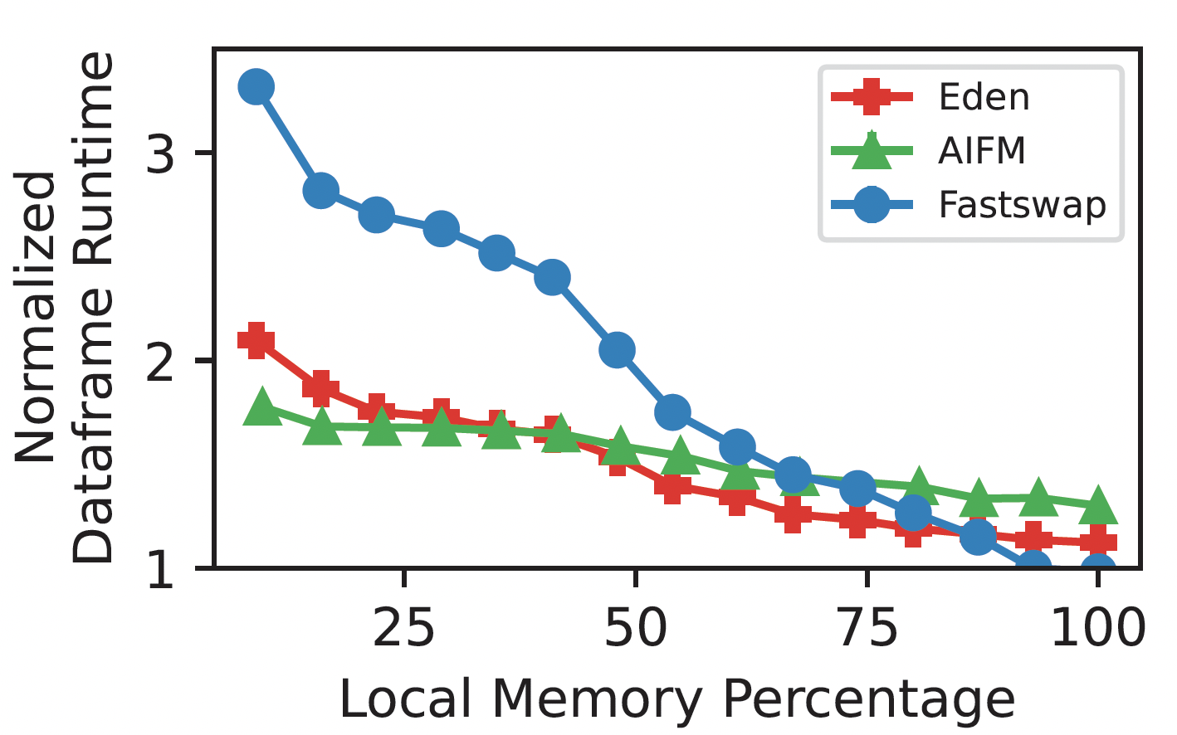
DataFrame Performance
Reduced hinting overhead
Aggressive read-ahead

Slide 28
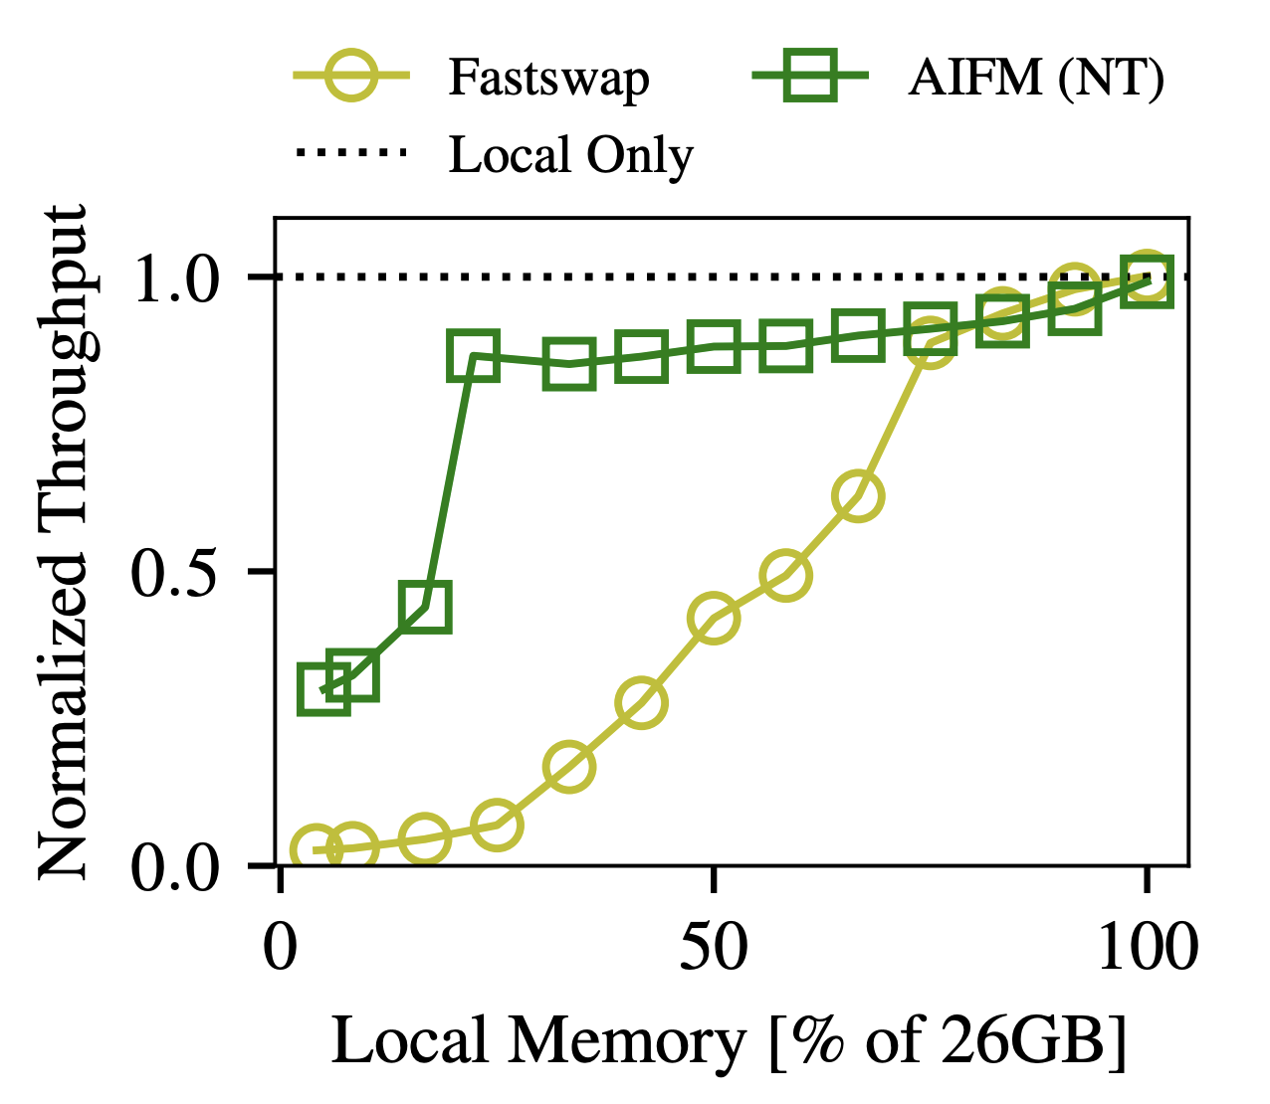
Emulating AIFM’s non-temporal access
Set objects “non-temporal” to avoid cache pollution
Segregated in the Cache
Prioritize on eviction
AIFM demonstrated with a Synthetic Web Service application
Small but perf-dominating hash table
Large-sized blob array
Sets blob array as “non-temporal” improves cache hits

Slide 29
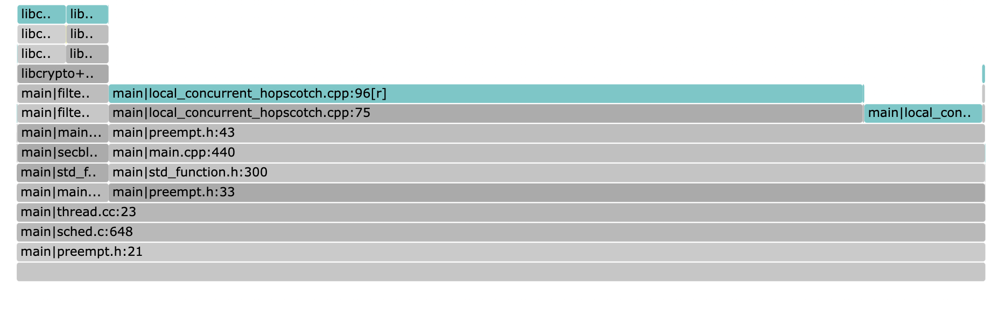
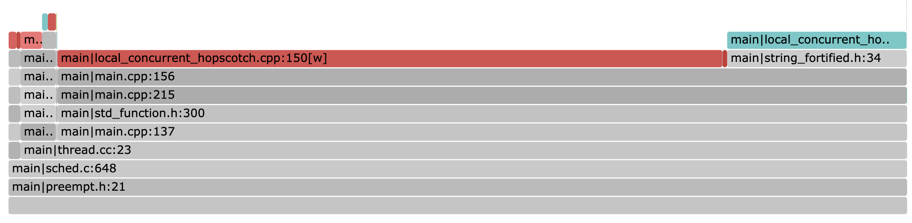
Case study: Memcached
Trace faults with Fltrace
Two hints in hash table
One for the blob array
Prioritize blob array for reclaim
(traced at local memory = 10% of the max resident set size)

Slide 30
Hinting AIFM’s Web Service

Slide 31
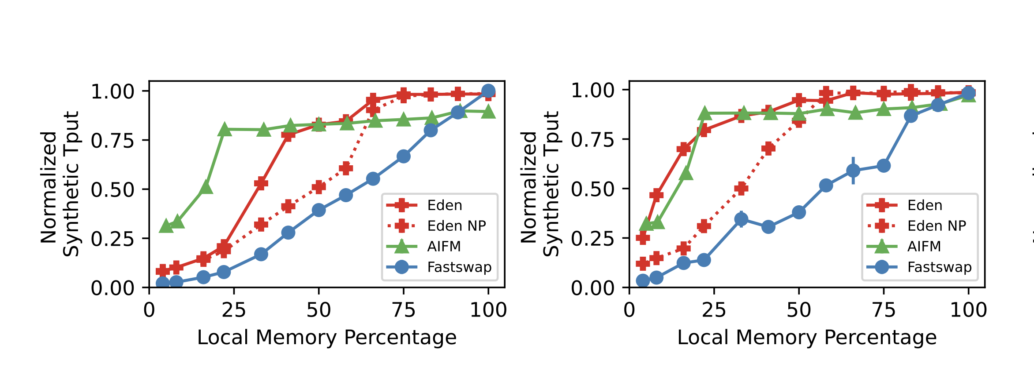
Performance
Value size: 32 B
Value size: 2 KB

Slide 32
Conclusion
A new point in far memory design space
Sacrifices little transparency for performance benefits of highly intrusive runtimes
This work is under review
AIFM
Eden
Performance
Fastswap
Less intrusive Interface

